Slide 1

Motorcycle sales analysis.
Regression analysis.

Slide 2


Contents
Introduction
Objective of analysis
Dataset description
Data cleaning and preprocessing
EDA
A) Price Distribution.
B) Brand Count.
C) Category of bike on demand
D) Selling and on-road price according to brand
Profit by city
Correlation
Regression analysis
Key insights& Conclusion.

Slide 3

Introduction.
This project is focused on the sales of the motorcycles and understand the profit trends, brand performing and category- wise sales using python. All the key insights, EDA, data cleaning is done with the help of python. In this project we will doing to focus on every column given here and conclude which column need to be more focused for more profit. We will achieve this task by performing predictive analysis by using regression model in excel.

Slide 4

Data description
Date
Order ID
Brand Name
Bike Model
Category
City
Cost Price
Selling Price
Discount
Profit
Insurance
Accessories
RSA
Total on road price
Customer feedback.

Slide 5
Data cleaning and preparation.
Staring with loading the data. We have convert the excel file into csv file in python.
We have customise our column names, to make it easy to use.
We have check the null values, there was null values in discount, accessories, RSA columns. We first replaced the values with NAN and then replace NAN to median as it is less sensitive to outliers.
As I changes the datatype for date, it was object earlier, for better analysis the date column is changes to datetime.
I performed Univariate, Bivariate analysis by using different type of plots and further we will see how all the variables is impacting to our profit column.

Slide 6
Exploratory data analysis.
There are total 105 records and 16 columns
No duplicated values to be found
Column names has changed to lowercase and separated by “_” for better analysis.
Null values found in “Discount”, “Accessories”, “RSA”, that has been changes to median, because there are extreme values present in data. Median is less sensitive to outliers.
Datatype for date is changed from object to datetime

Slide 7

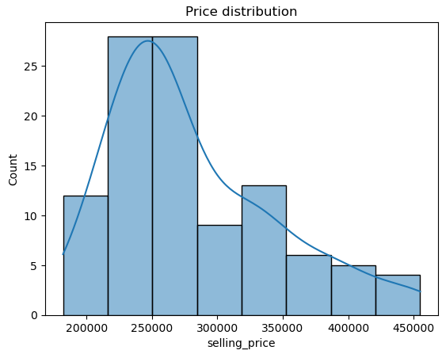



Price Distribution.
X-axis= Selling Price
Y- axis= Count
As we can check in this figure. The KDE that is kernel density estimator is right skewed, which is positive skewed. Here we can check that most of the bike is sold between ranges 2lakh to 3 lakh. The heights peak is around 2.4 to 2.6 lakh.
The motorcycle which is above 4 lakh is seem to be less as compared to other ranges.

Slide 8
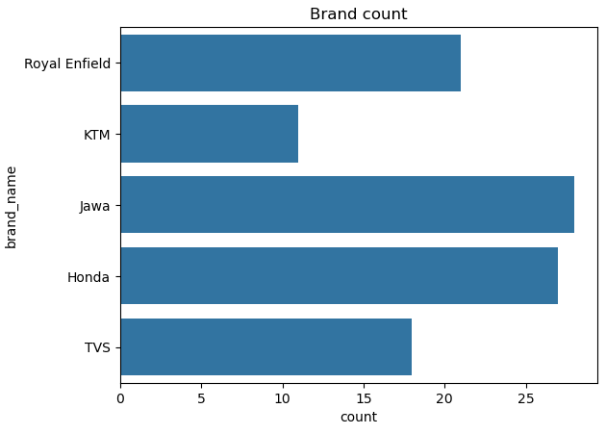
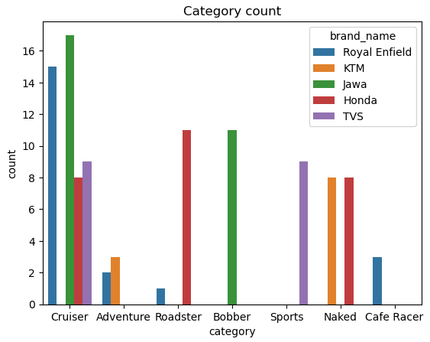
Brand Count.
Here we can check that the highest brand is sold is Jawa and Hondas compare to others.
Well, if we check the second figure that says that cruiser is dominated by Jawa and Royal Enfield
Brands focusing on Cruiser, Roadster and bobber can generate high revenue.
Here we can see the least revenue making model is café racer and roadster by Royal Enfield, yet the price is high, but demand is low.

Slide 9
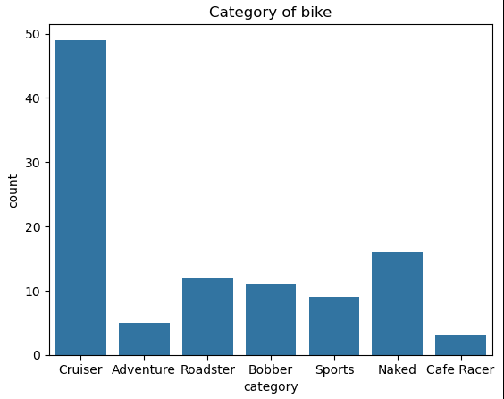
Category of bike on demand.
If we check the category of bike on demand.
Cruiser is the most demanding model that is on demand, it is the most preferred category.
Reason:
It is more comfortable for long rides.
Popular among Indian customers
Strong brand represents Jawa and Royal Enfield.

Slide 10
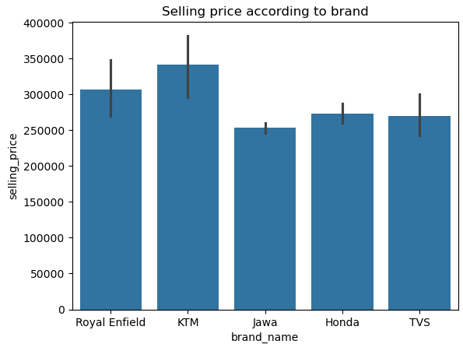
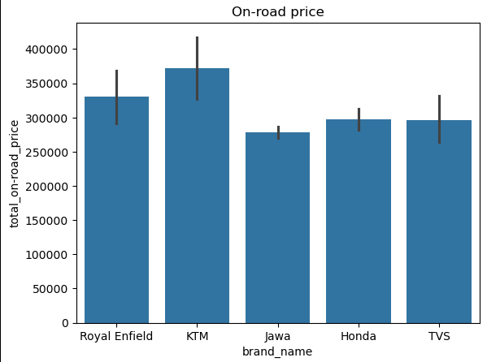
Selling price and on –road price according to brand.
Premium: KTM, Royal Enfield
Mild- range: Honda, TVS
Affordable: Jawa
As we can see here that brand like Jawa, Honda and TVS has less selling price as compare to others.
Well looking at KTM it is sports oriented bike and not comfortable for daily practice.

Slide 11
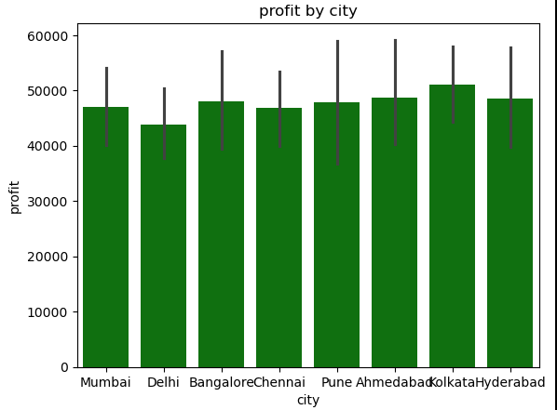
Profit by city.
Most profit making city is Kolkata. Kolkata is high performing profit centre here.
Hyderabad and Ahmednagar are also high profit levels close to top.
Pune, Chennai and Bangalore are stable profit are in mid range segment.

Slide 12
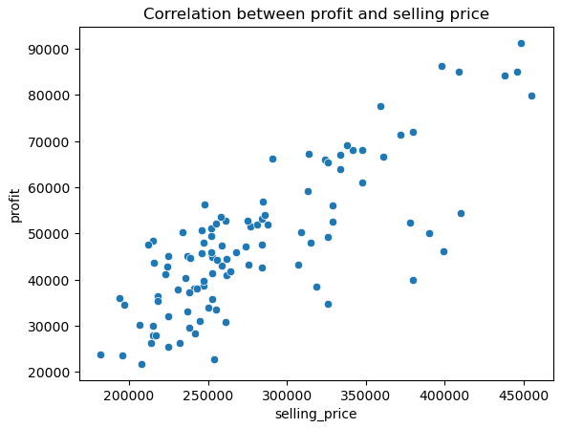
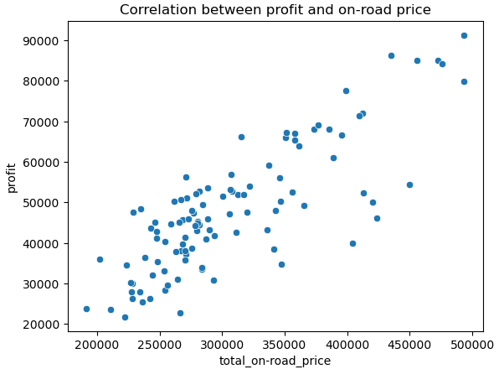
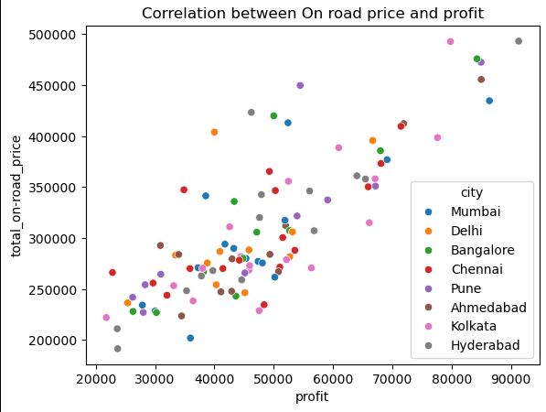
Correlation.

Slide 13

Correlations.
1) Correlation between Profit and selling price
As we can check that profit and selling price is highly correlated to each other. It is positively correlated to each other.
This means, higher the selling price higher will be the profit.
This individual is not impacted to profit other factors is also come in picture.
2) Correlation between profit and on-road price.
Here we can see that even on road price is positively correlated to profit.
If higher the on road price the profit will increase accordingly.
If we can see the third figure the profit is scattered by cities.

Slide 14

Regression analysis.

Slide 15
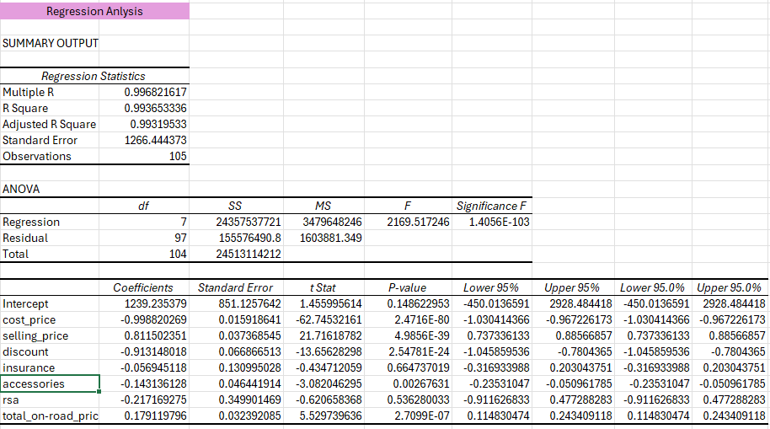
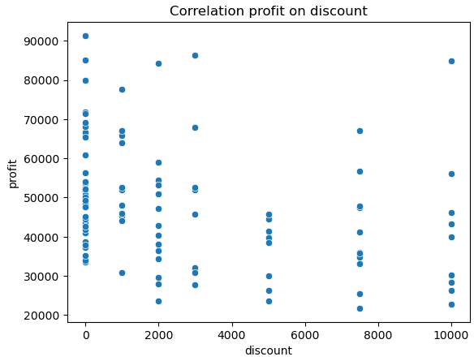
Correlation profit on discount.
P-value : 2.47E-124
Coefficient: 0.91
As we can check the P-Value which is less than 0.05 which is significantly related but not affecting the profit that much.

Slide 16
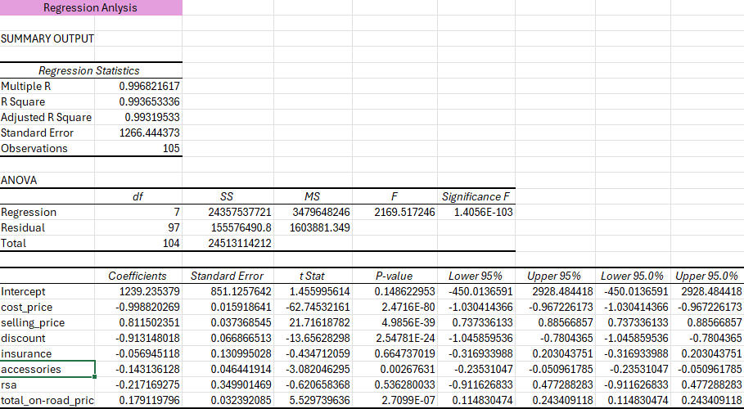

Correlation profit by selling price.
As we discussed earlier that selling price is positively correlated to profit.
If we check the regression part
Coefficient: 0.81
P-value- ~0
Selling price is strongly increasing the profit.

Slide 17
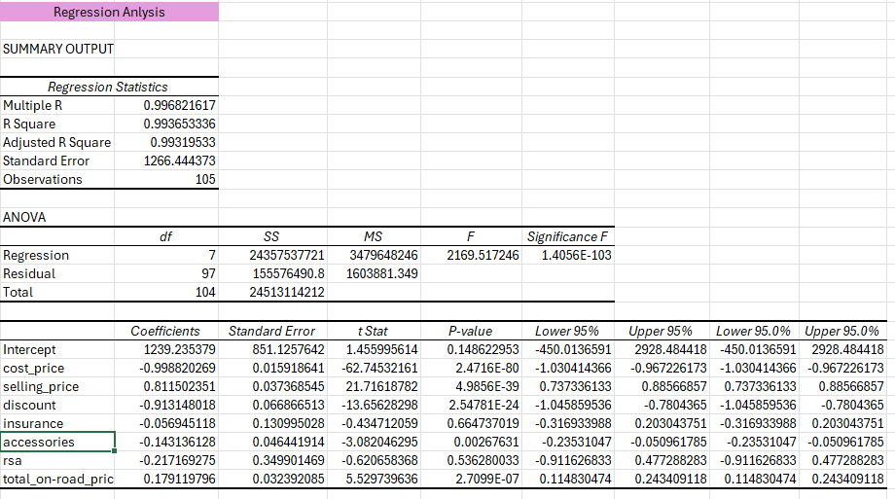
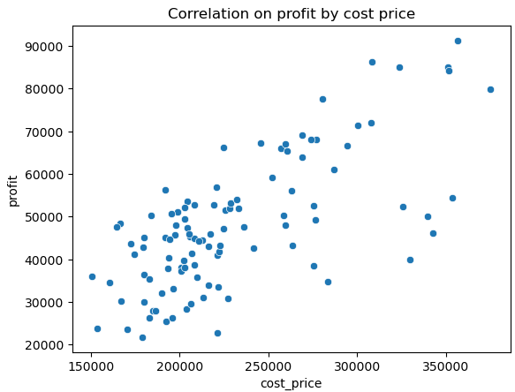
Correlation on profit by cost price.
P- Value= ~0
Coefficient: 0.99
Well, if we see the correlation it is closer to 1 so it is strongly correlated to the profit.
The p-value is less than 0.05, we it is significant to the profit column.
If there is increase in cost price eventually the profit will also increase, as it is positively correlated to each other.

Slide 18
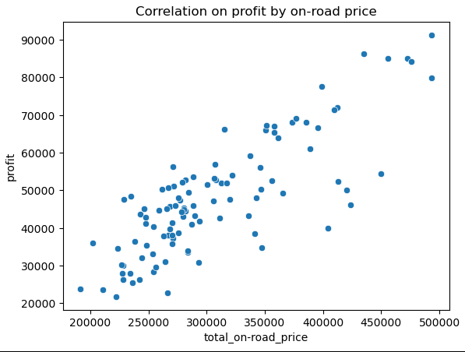

Correlation on profit by on-road price.
The correlation analysis between profit and on-road price is positive.
If on-road price increases profit is also increases and the P-value is also significant.
This can consider the good impact on profit.

Slide 19

Key insights & Conclusion.
The regression model is highly accurate and statically significant. Cost price and selling price are the strongest predictors, while discount do not contribute meaningfully. The model can be reliably used for prediction and business decision making.
Cost price, selling price & on-road price are primary drivers.

